Slide 1

SmartShelfX – Inventory Forecast & Auto-Restock
Group Members :
Salani Madhuri
Ilakkiya K
Alvin M Josan
Mentor : Suramya Biswas

Slide 2






Agenda
Introduction
Technology Stack
Implemented Modules
Key Outputs
Future Enhancements
Conclusion

Slide 3
Introduction
SmartShelfX is a web-based inventory management system that helps streamline product tracking and stock control .
The system maintains accurate stock data through Stock-In/Stock-Out records and Stock Keeping Unit (SKU)-based product management.
An interactive dashboard and analytics module provides insights into product performance and overall inventory trends.
It uses React for the user interface, Spring Boot for the server, and MySQL for storing data.

Slide 4
Technology Stack
Layer
Technology Used
Frontend
React
Backend
Java, Spring Boot 3+, Spring Security, Spring Data JPA
Database
MySQL 8
Visualization
Chart.js
Tools used for development
Eclipse IDE, VS Code, MySQL Workbench

Slide 5
Implemented Modules
🟢 1. User & Role Management
🟢 2. Product Management
Roles: Admin, Manager, Vendor
Role-based access for product management.
Secure authentication (encrypted passwords)
Each Product List includes: SKU, Vendor, Price, Reorder Level, Current Stock and Status.
Dashboard with role-specific access
🟢 3. Stock-In / Stock-Out Transactions
🟢 4. SKU Management
Record Purchases and Issues.
Role-based access for SKU management.
Tracks Date and Quantities for every transactions.
Each SKU List includes: SKU Id, SKU Description.
🟢 5. Alerts
🟢 6. Analytics Dashboard & Reports
Alerts when stock reaches Reorder level.
Single and Overall Product Summary and Analysis.
Visualization of product demand.

Slide 6

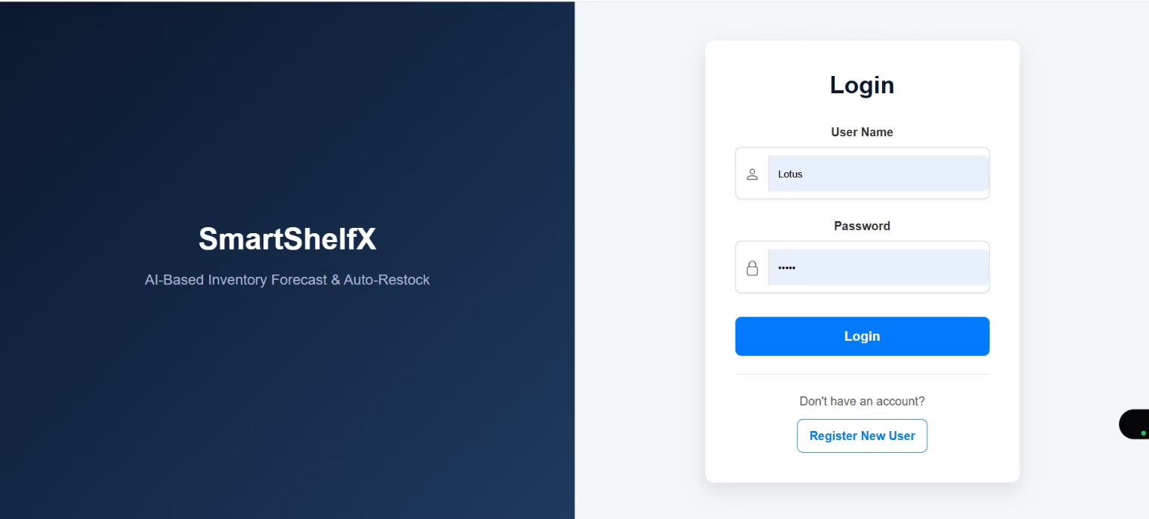
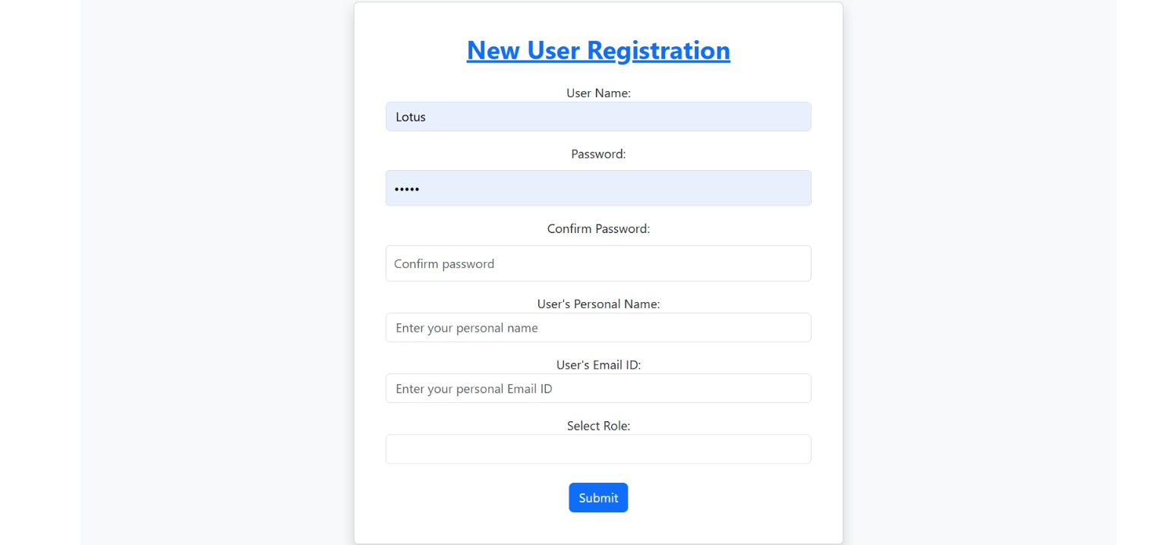
Key Outputs
Login Interface
Registration Form
Secure user authentication
User registration interface

Slide 7
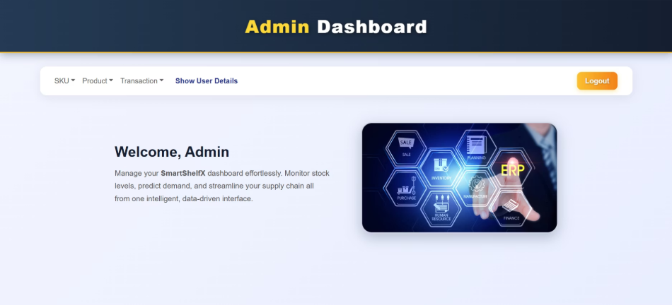
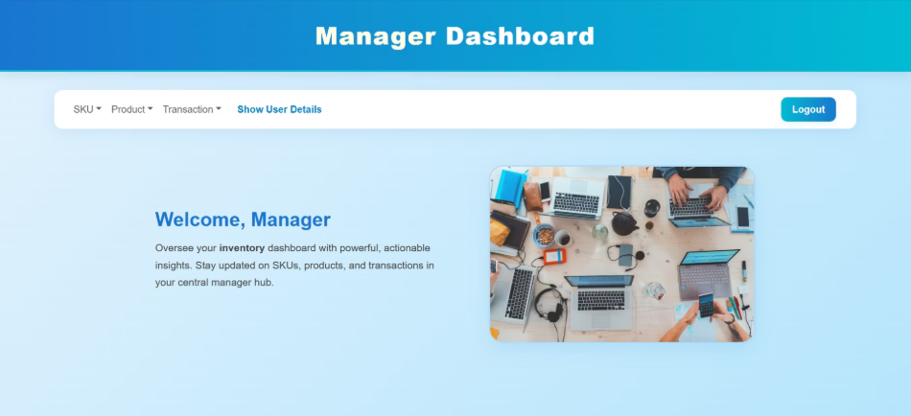
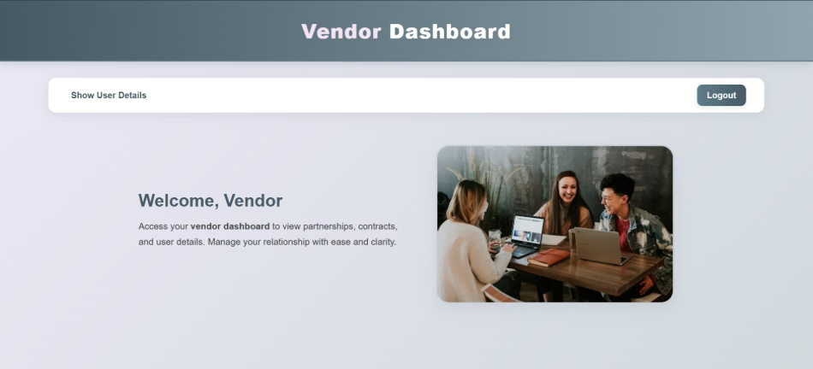
Admin Dashboard
Manager Dashboard
Vendor Dashboard
Showing current stock, alerts, and restock summary.
For viewing and managing all items in one place.
For generating and managing vendor Purchase Orders.

Slide 8
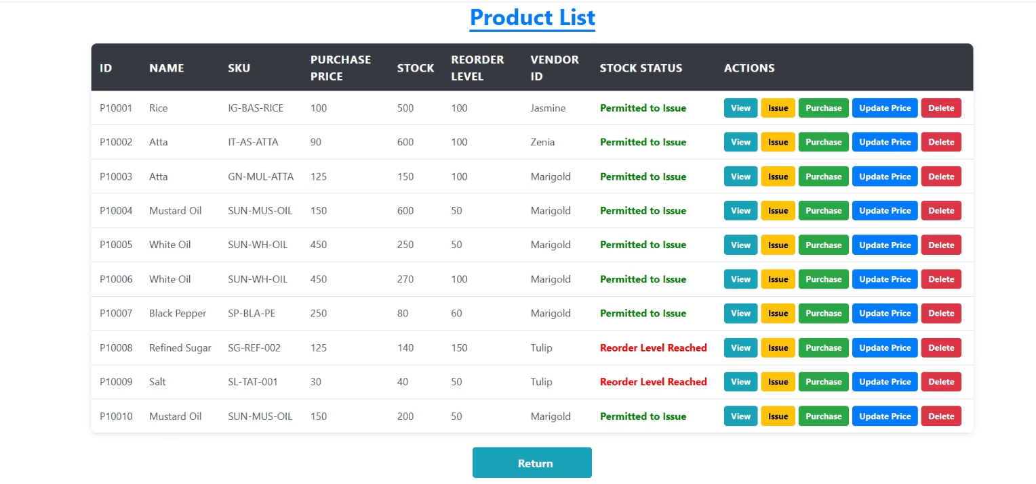
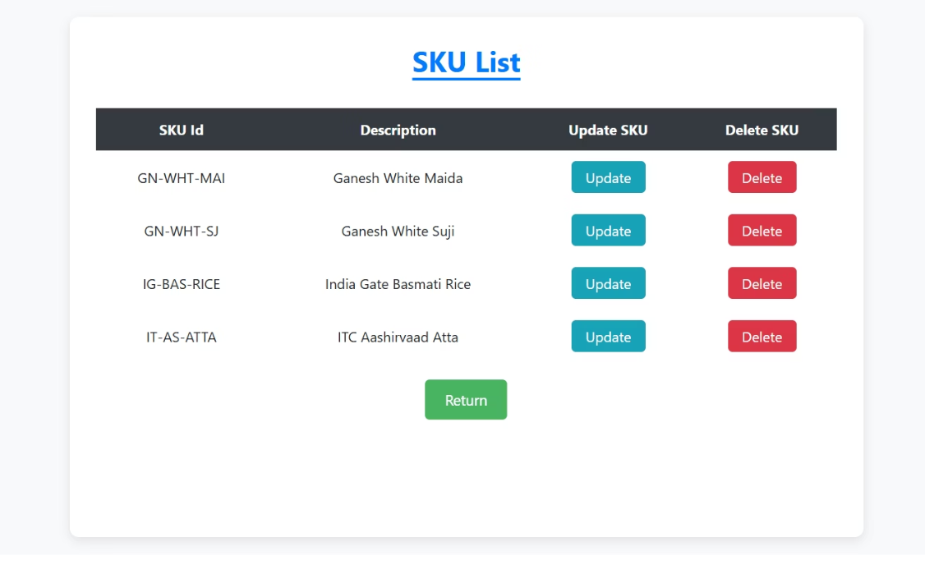
Product List
SKU List
Product management interface for Admin and Manager.
SKU management interface for Admin and Manager.

Slide 9
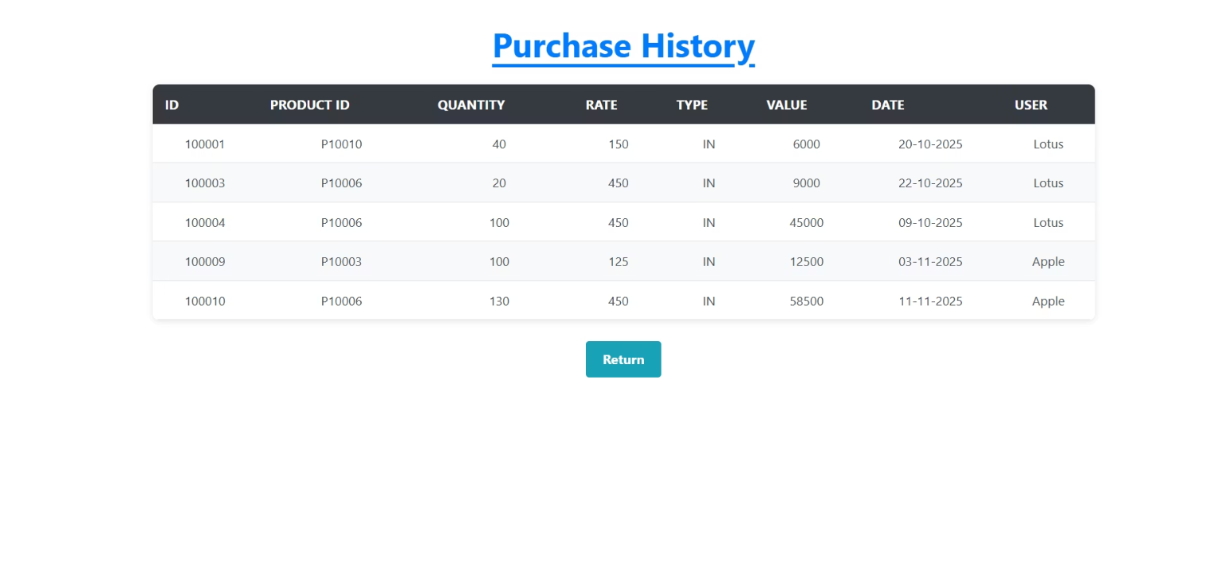
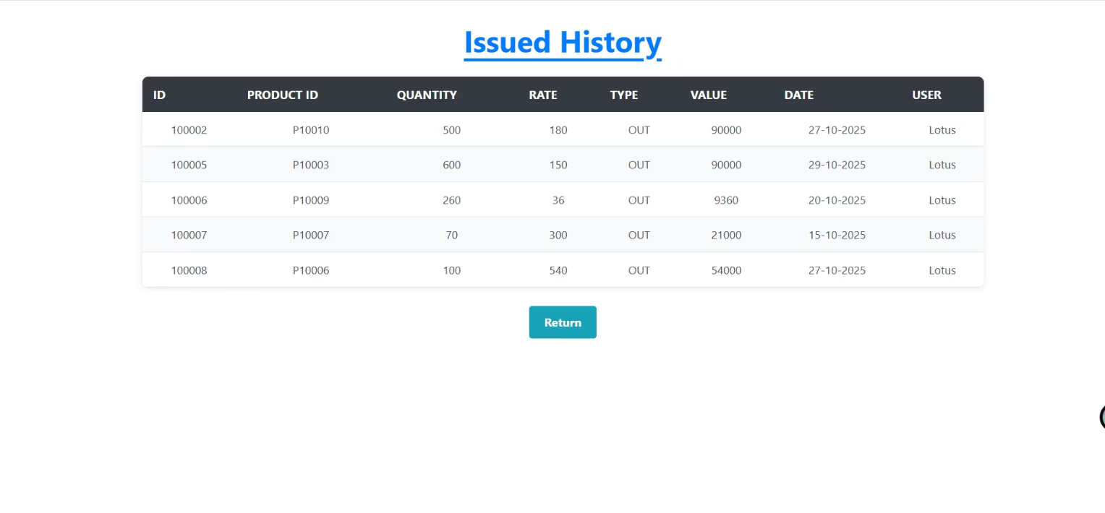
Stock-In
Stock-Out
Detailed history and analysis of products purchased.
Detailed history and analysis of Products Issued.

Slide 10

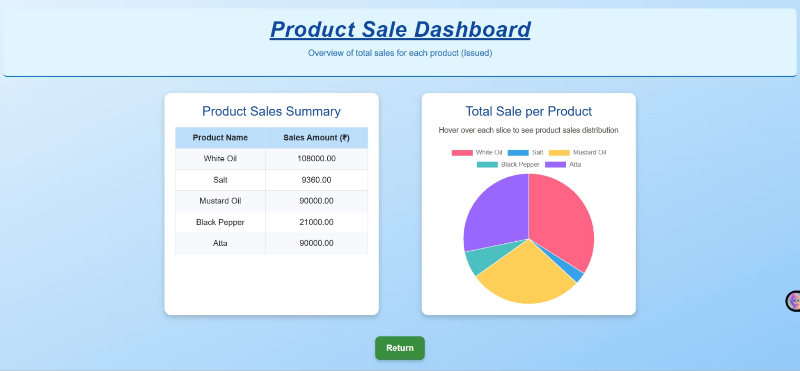
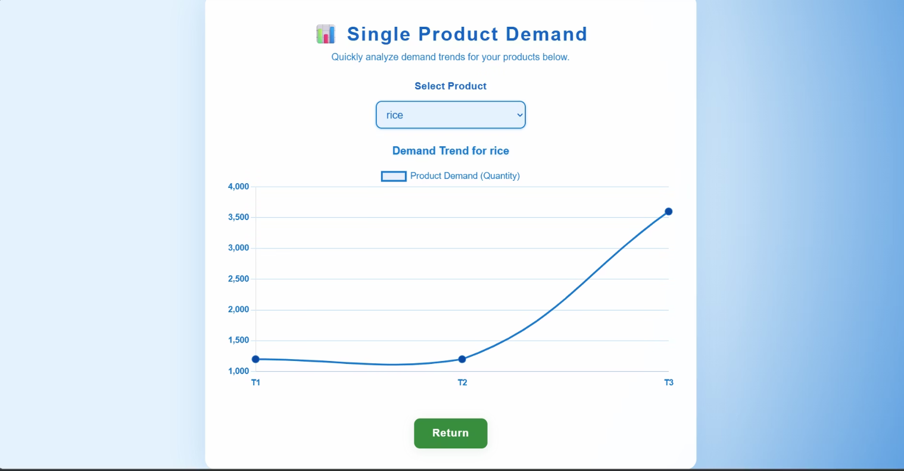
Product Sales Dashboard
Single Product Demand
Visualize the total sales distribution across all products using detailed charts and summaries.
Analyze the demand patterns and performance of a single product.

Slide 11

Future Enhancements
Batch Import & Barcode Scanning
AI-Based Demand Forecasting
Enable CSV import/export and barcode-based product entry.
Integrate TensorFlow/Scikit-learn models to predict demand and automate restocking.
Mobile Application
Vendor Communication System
Android/iOS app for quick inventory updates on the go.
Real-time vendor dashboard for PO confirmation and messaging.

Slide 12
Conclusion
SmartShelfX automates stock tracking and restocking effectively.
It minimizes manual work .
Provides a centralized dashboard for all roles to access key information.
Built with scalability in mind — ready for AI and mobile expansion in future.
Ensures efficient warehouse management and smarter inventory decisions.
Smarter Inventory, Seamless Operations.

Slide 13
Thank You

